Slide 1


Artificial
Intelligence
Title: Tumor Trace: MRI-Based AI for Breast Cancer Detection
Name: Shravani Sanjay More
Theme : AI First
Platform : Infosys Springboard
Mentor: Anurag Sista
01

Slide 2

Project Overview
Objective :
Build a machine learning model to classify breast cancer status (benign or malignant) using MRI images.
Goal :
Aid in the early detection of breast cancer to improve patient outcomes.
Approach :
Utilize deep learning models, data preprocessing, and evaluation metrics to predict tumor status.
02

Slide 3

Problem Statement
The Problem :
Breast cancer is a major cause of death among women worldwide.
Early detection plays a vital role in improving survival rates.
Manual analysis of MRI scans is slow, expensive, and prone to errors.
The Need :
Automated, accurate, and fast classification of MRI scans to detect cancer earlier and more reliably.
This project aims to develop a machine learning model that can accurately classify MRI images as benign or malignant, thereby aiding in early detection and diagnosis of breast cancer."
03

Slide 4

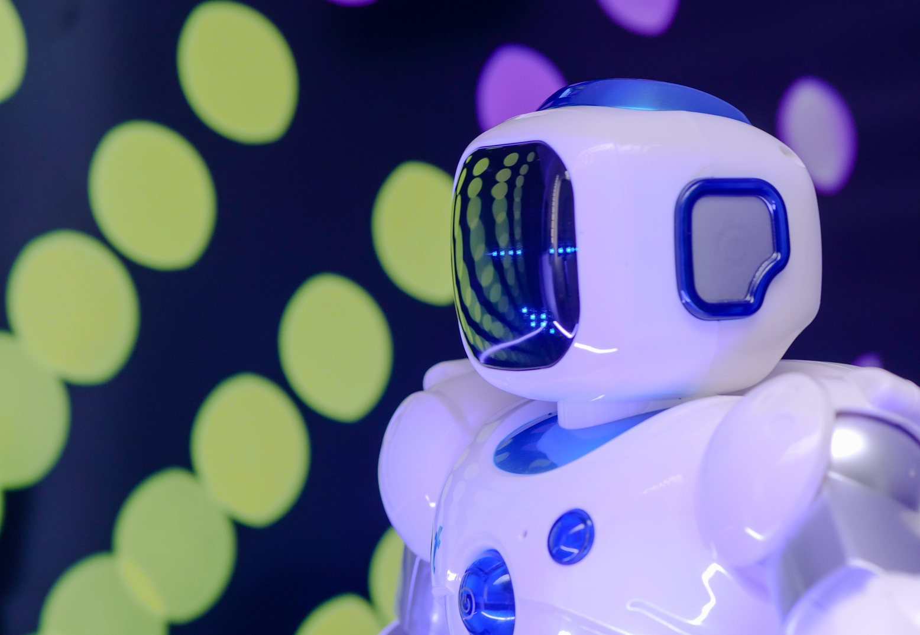
Overview :
Data collection from MRI images
Preprocessing for model input
Model training
Evaluation
GUI ( Gradio & Web application)
Steps :
Data Collection – Obtain labeled MRI datasets.
Data Preprocessing – Resize images, normalize pixel values, data augmentation.
Model Development – Implement deep learning models (VGG16, ResNet).
Evaluation – Assess performance using metrics like accuracy, precision, recall, F1 score, AUC curve, confusion matrix.
Methodology
04

Slide 5


Data Collection and Preprocessing
Dataset :
Dataset contains MRI images labeled as either benign or malignant.
Source of Dataset : Computers in Biology and Medicine
Preprocessing Steps :
Grayscale Conversion : Convert images to grayscale.
Resizing : Resize images to a standard dimension (i.e. 224x224).
Normalization : Normalize pixel values to a range suitable for neural network input.
Augmentation : Apply techniques such as rotation and flipping to augment the dataset.
Handling Class Imbalance: Use techniques like Class weights.
05

Slide 6

Models Used and Development
Models :
VGG16: A convolutional neural network with 16 layers.
ResNet18 and ResNet50: Deeper architectures using residual connections for improved training.
Model Selection :
VGG16 : Chosen for its simplicity and effectiveness in image classification.
ResNet18 & ResNet50 : Chosen for better performance in deeper layers with residual learning.
Development Steps :
Initialize pre-trained models.
Fine-tune on breast cancer dataset.
Train and validate models.
06

Slide 7


Evaluation Metrics
Accuracy : The percentage of correct predictions out of all predictions.
Precision : Ability of the model to avoid false positives.
Recall: Ability of the model to identify actual positive cases (sensitivity).
F1 Score : Harmonic mean of precision and recall.
AUC (Area Under Curve) : Measures how well the model distinguishes between benign and malignant tumors.
Confusion Matrix : Table that helps you understand the performance of your classification. It shows the counts of true positives, true negatives, false positives, and false negatives.
07

Slide 8

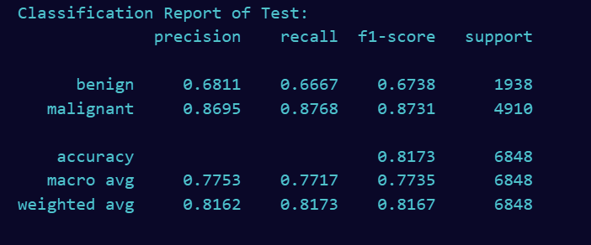
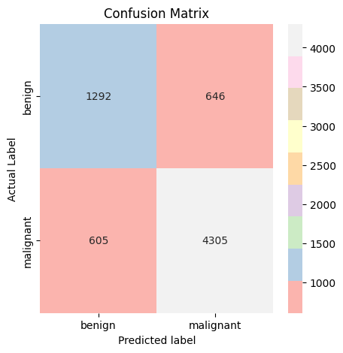
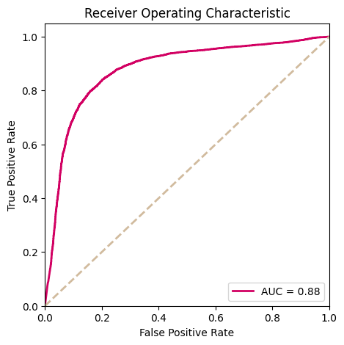
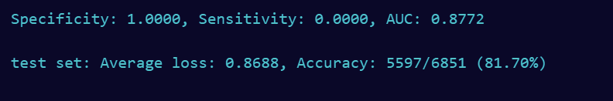
Results and Impact
Model – VGG16
Accuracy: 81.70%, AUC: 0.8772
CLASSIFICATION REPORT OF TEST :
CONFUSION MATRIX :
Benign Tumors (Actual Benign):
Correctly Predicted as Benign: 1292
Incorrectly Predicted as Malignant: 646
Malignant Tumors (Actual Malignant):
Correctly Predicted as Malignant: 4305
Incorrectly Predicted as Benign: 605
08

Slide 9
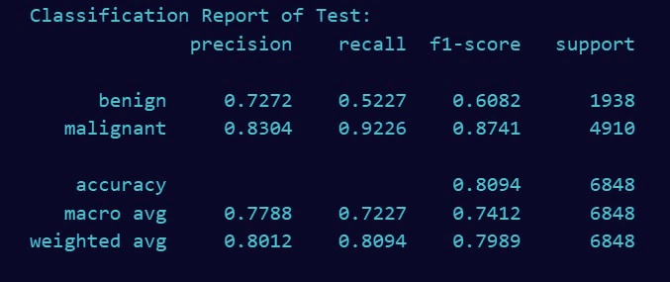
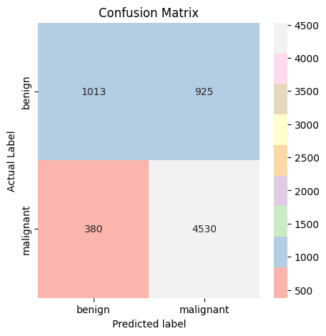
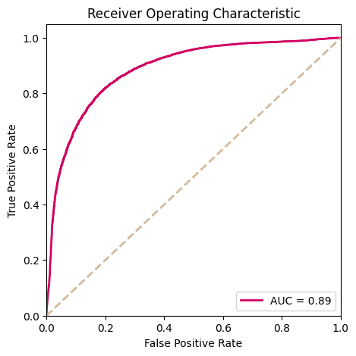
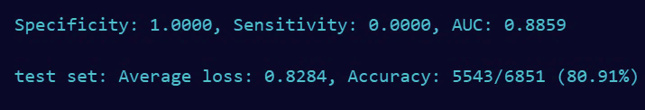
Results and Impact
Model – Resnet 18
Accuracy: 80.91%, AUC: 0.8859
CLASSIFICATION REPORT OF TEST :
CONFUSION MATRIX :
Benign Tumors (Actual Benign):
Correctly Predicted as Benign: 1013
Incorrectly Predicted as Malignant: 925
Malignant Tumors (Actual Malignant):
Correctly Predicted as Malignant: 4530
Incorrectly Predicted as Benign: 380
09

Slide 10

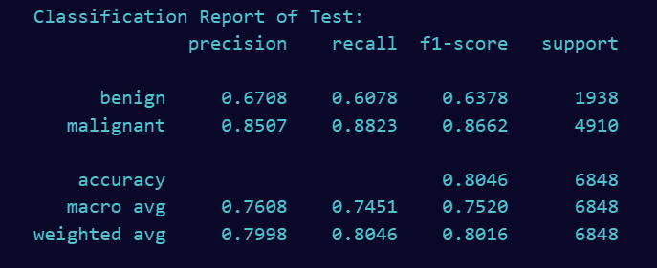

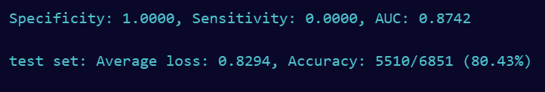
Results and Impact
Model – Resnet 50
Accuracy: 80.43%, AUC: 0.8742
CLASSIFICATION REPORT OF TEST :
CONFUSION MATRIX :
Benign Tumors (Actual Benign):
Correctly Predicted as Benign: 1178
Incorrectly Predicted as Malignant: 760
Malignant Tumors (Actual Malignant):
Correctly Predicted as Malignant: 4331
Incorrectly Predicted as Benign: 578
10

Slide 11
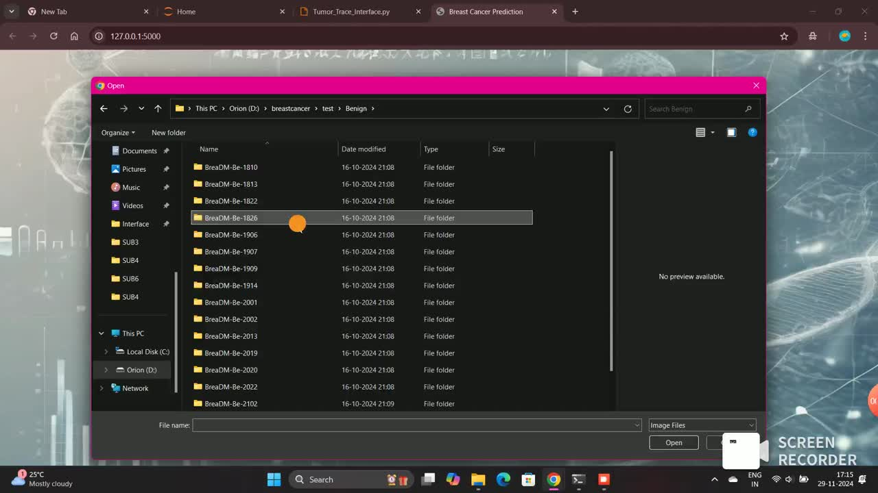

Slide 12


Thank you
12

